Slide 1
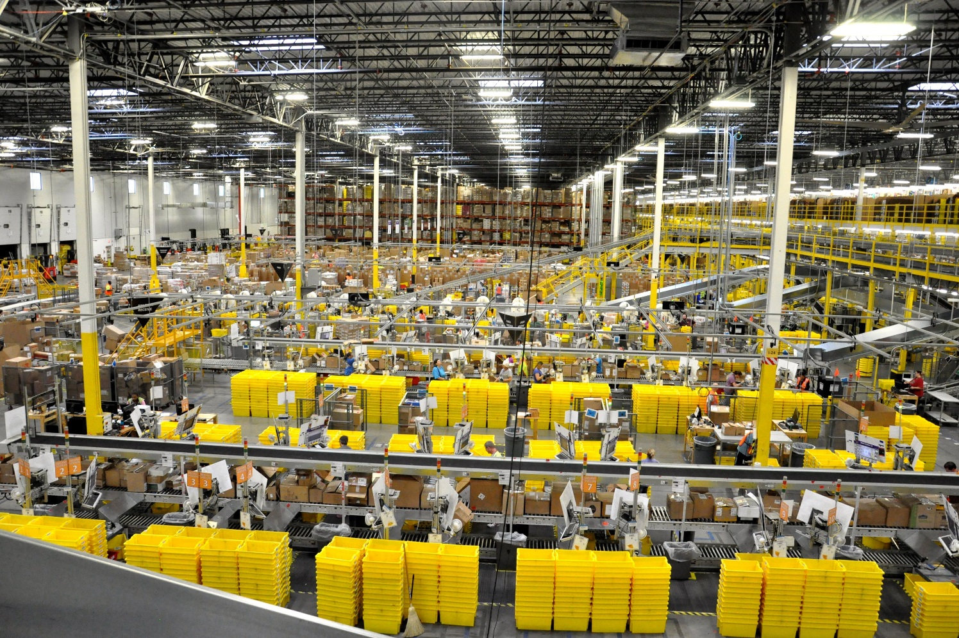
ILAC Start Up Meeting

Slide 2

Phrase of the Day

Slide 3
Announcements

Slide 4


Slide 5


Slide 6
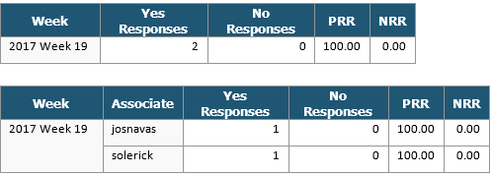
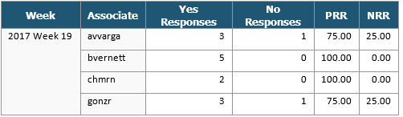
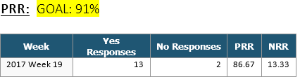
How are we doing so far in WW 19?
PRR:
High Value:
Low Value:
Team Total:

Slide 7
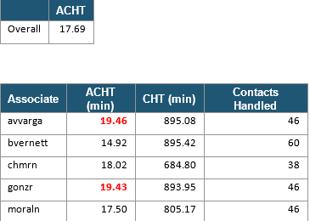
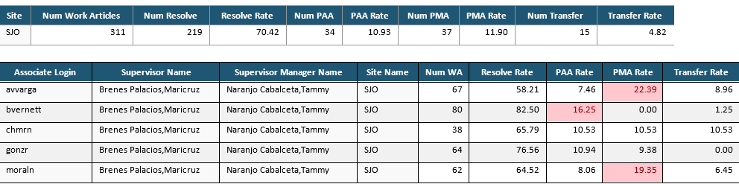
How are we doing so far in WW 19?
AHT/RR:

Slide 8
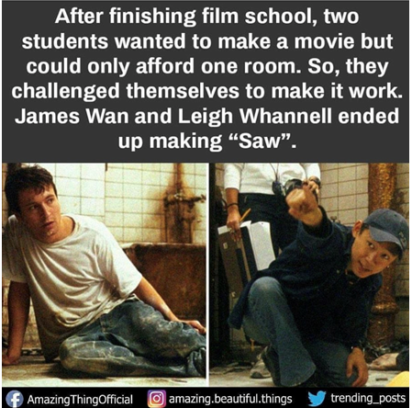
Did you know…?

Slide 9

Anything else?
Send me an email avvarga@

